Slide 1

Joy Lutheran Licensing
Augsburg Fortress: #SAS000441
CCLI: #11269767
CCLI Streaming: #21774684
One License: #A-719954

Slide 2
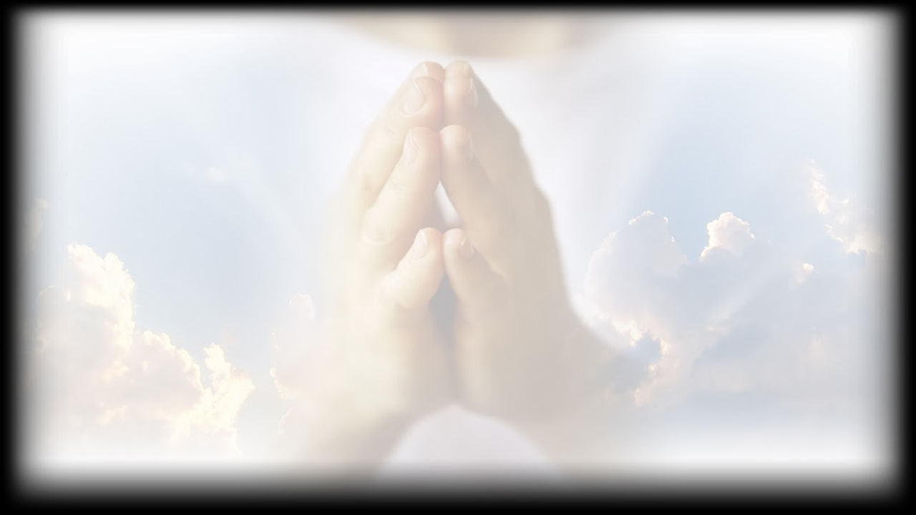
As a courtesy to others,
we ask that you please keep conversations low and to a minimum.
PLEASE MAKE SURE
ALL CELL PHONES ARE SILENCED.
Thank You.

Slide 3
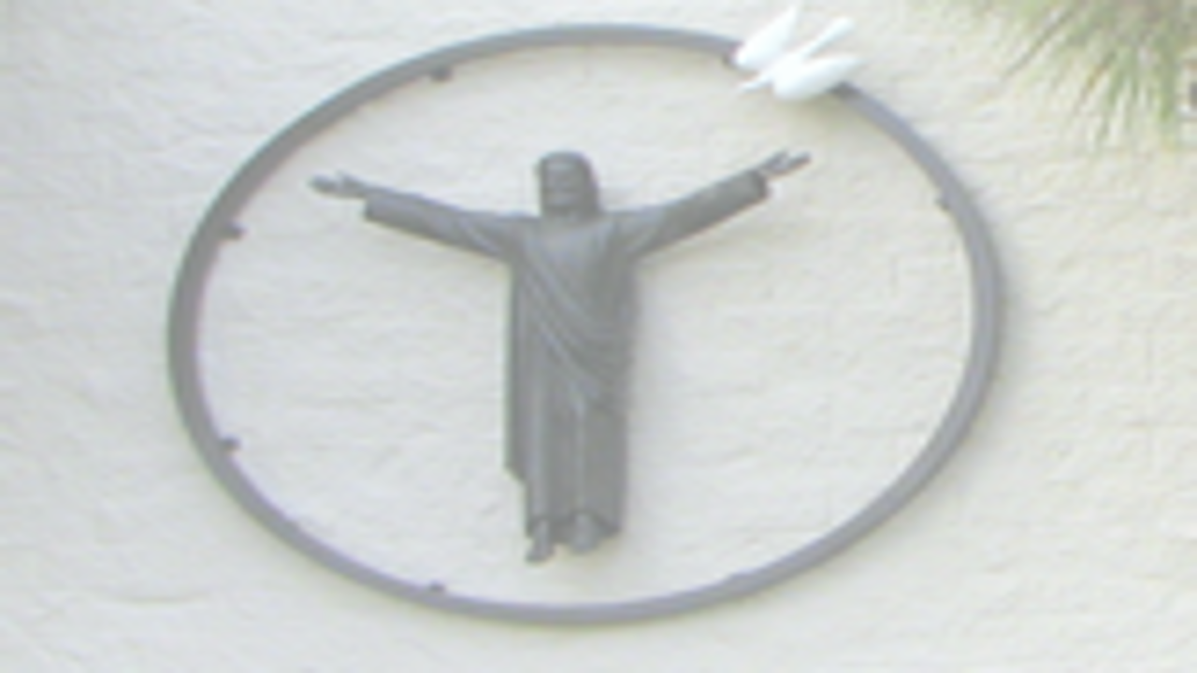
Our mission is to share
the Good News
of grace and love with all through worship, service,
and fellowship.

Slide 4
Our Vision:
Joy is a spiritual community
sharing the love of Christ in a
challenging world.

Slide 5
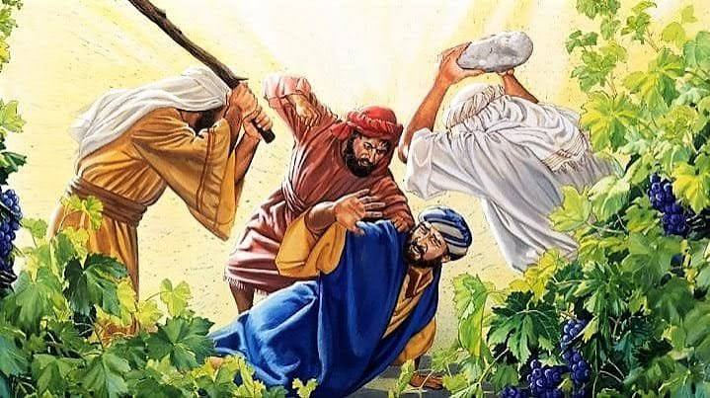
19th Sunday After Pentecost--October 4, 2026

Slide 6
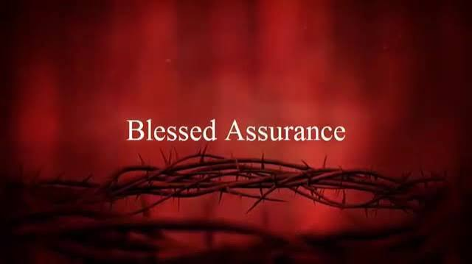
PRELUDE
Arr. Zack James

Slide 7
CONFESSION AND FORGIVENESS
P Blessed be the holy Trinity,☩ one God,
who pours love into our hearts and healing
upon the earth.
C Amen.
P Confident that God justifies us by grace
through faith, let us confess our sin.
Silence is kept for reflection

Slide 8
P Compassionate God,
C we confess that we struggle to embody your goodness in the world and in our own
hearts. Creation groans from overuse.
Jealousy and bitterness strain our
relationships. Indifference keeps us from
seeking justice.

Slide 9
C Divisions disrupt your call to show
genuine love to others.
Turn our hearts back to you.
Restore our world and reconcile us to one
another. Renew us to live as your holy
people, following the way of Jesus Christ.
Amen.

Slide 10
P Hear this good news:
We have peace with God through ☩ Jesus
Christ, in whom there is no condemnation,
but only forgiveness and the promise of
eternal life. Receive freely this healing gift
of grace.
C Amen.

Slide 11
GATHERING HYMN:
“My Lord Of Light”
ELW # 832

Slide 12
1
My Lord of light
who made the worlds,
in wisdom you have spoken;

Slide 13
but those who heard
your wise commands
your holy law have broken.

Slide 14
2
My Lord of love
who knew no sin,
a sinner's death enduring:

Slide 15
for us you wore
a crown of thorns,
a crown of life securing.

Slide 16
3
My Lord of life
who came in fire
when Christ was high ascended:

Slide 17
your burning love
is now released,
our days of fear are ended.

Slide 18
4
My Lord of lords,
one Trinity,
to your pure name be given

Slide 19
all glory now
and evermore,
all praise in earth
and heaven.

Slide 20
Greeting
P: The love of God poured into our hearts, the saving grace of Jesus Christ, and the abundant life of the Holy Spirit be with you all.
C: And also with you.

Slide 21
KYRIE:
“Kyrie Eleison”
ACS Setting 12

Slide 22
Kyrie eleison.
Lord, have mercy.
Christe eleison.
Christ, have mercy.
Kyrie eleison.
Lord, have mercy.

Slide 23
PRAYER OF THE DAY
P: Let us pray.
C: Beloved God, from you come all things
that are good. Lead us by the inspiration
of your Spirit to know those things that
are right, and by your merciful guidance,
help us to do them, through Jesus Christ,
our Savior and Lord. Amen.

Slide 24
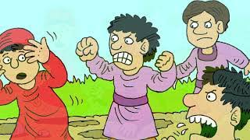
CHILDREN’S MESSAGE: 11:00 AM
WHAT
DID
THE
TENANTS
DO?
Notes:
8:15 AM SKIP THIS SLIDE—FOR 11:00 AM SERVICE

Slide 25
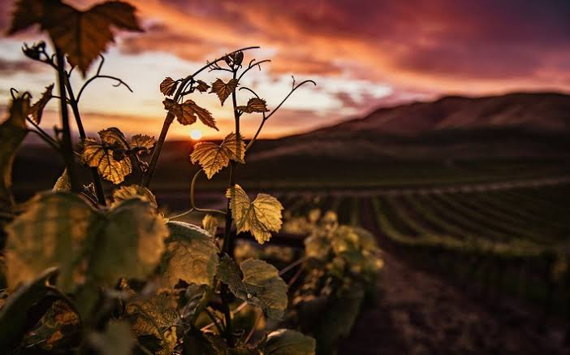
ISAIAH
5:1-7
The Song
of the
vineyard.
Notes:
ADVANCE SLIDE ON LAST VERSE WHICH begins: ⁷ For the vineyard of the Lord of hosts is the house of Israel, and the people of Judah are his cherished garden; he expected justice
but saw bloodshed; righteousness but heard a cry!

Slide 26

P: The word of the Lord.
C: Thanks be to God.

Slide 27
PSALM 80:7-15
R: Look down from heav’n, O God; behold and tend this vine. (Ps. 80:14-15)
⁷ Restore us, O | God of hosts;
let your face shine upon us, and
we | shall be saved.

Slide 28
⁸ You have brought a vine | out of
Egypt; you cast out the nations
and | planted it.
⁹ You cleared the | ground for it;
it took root and | filled the land.

Slide 29
¹⁰ The mountains were covered | by its
shadow and the towering cedar trees | by
its boughs. R
Look down from heav’n, O God;
behold and tend this vine.

Slide 30
¹¹ You stretched out its tendrils | to
the sea and its branches | to the river.
¹² Why have you broken | down its wall,
so that all who pass by pluck | off its
grapes?

Slide 31
¹³ The wild boar of the forest has |
ravaged it, and the beasts of the field
have | grazed upon it.
¹⁴ Turn now, O | God of hosts,
look | down from heaven;

Slide 32
¹⁵ behold and | tend this vine;
preserve what your right | hand has
planted. R
Look down from heav’n, O God;
behold and tend this vine.

Slide 33

Philippians
3:4b-14
Nothing
surpasses
the value
of knowing
Christ.
Notes:
^{DVANCE SLIDE ON LAST VERSE} ¹⁴ I press on toward the goal, toward the prize of the heavenly call of God in Christ Jesus.

Slide 34
P: The word of the Lord.
C: Thanks be to God.

Slide 35

CHOIR ANTHEM:
JOY Choir

Slide 36
GOSPEL ACCLAMATION:
“Alleluia”
ACS Setting 12

Slide 37
Alleluia, alleluia, alleluia.
Lord, to whom shall we go?
You have the words of eternal life.
Alleluia, alleluia, alleluia.

Slide 38
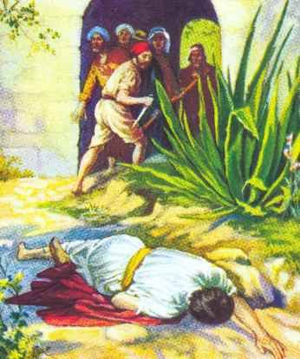
P: The Holy Gospel According to
Matthew
21: 33-46
C: Glory to
you O Lord
Notes:
ADVANCE SLIDE ON THE LAST VERSE WHICH BEGINS ⁴⁶ They wanted to arrest him, but they feared the crowds, because they regarded him as a prophet.

Slide 39
P: The Gospel of the Lord.
C: Praise to you, O Christ.

Slide 40

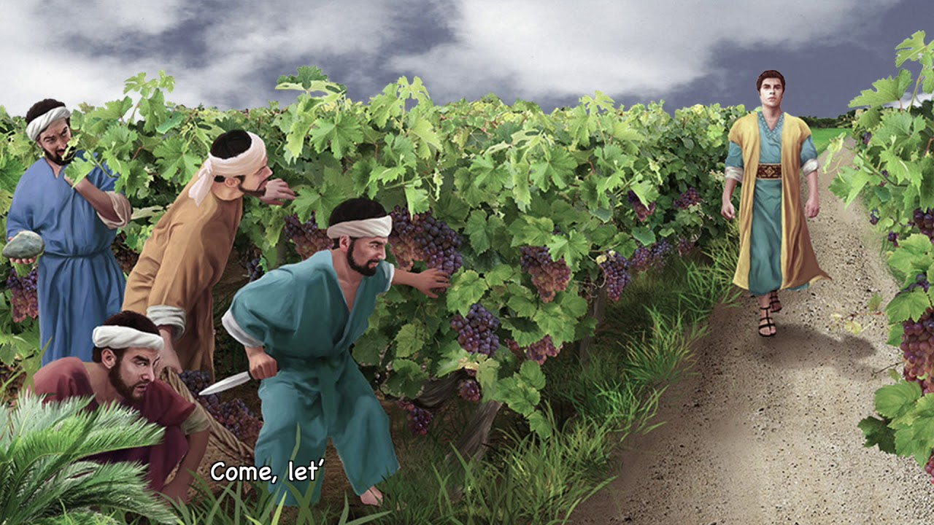
Today’s Message Is Given By:
Pr. Art Wuertz

Slide 41
a moment of silence
for reflection

Slide 42
HYMN OF THE DAY:
I CAN ONLY IMAGINE
CCLI # 297887

Slide 43
1
I can only imagine
What it will be like
When I walk by Your side

Slide 44
I can only imagine
What my eyes will see
When Your face
is before me
I can only imagine

Slide 45
Chorus
Surrounded by Your glory
What will my heart feel
Will I dance for You Jesus
Or in awe of You be still

Slide 46
Will I stand in
Your presence
Or to my knees
will I fall
Will I sing hallelujah

Slide 47
Will I be able
to speak at all
I can only imagine
I can only imagine

Slide 48
2
I can only imagine
When that day comes
And I find myself
standing in the Son
I can only imagine

Slide 49
When all I will do
Is forever forever
worship You
I can only imagine
I can only imagine

Slide 50
Chorus
Surrounded by Your glory
What will my heart feel
Will I dance for You Jesus
Or in awe of You be still

Slide 51
Will I stand in
Your presence
Or to my knees
will I fall
Will I sing hallelujah

Slide 52
Will I be able
to speak at all
I can only imagine
I can only imagine

Slide 53
Chorus
Surrounded by Your glory
What will my heart feel
Will I dance for You Jesus
Or in awe of You be still

Slide 54
Will I stand in
Your presence
Or to my knees
will I fall
Will I sing hallelujah

Slide 55
Will I be able
to speak at all
I can only imagine
I can only imagine

Slide 56
Tag
I can only imagine
I can only imagine
I can only imagine
I can only imagine

Slide 57
Ending
I can only imagine
when all I will do
Is forever forever
worship You
I can only imagine

Slide 58
Apostles’ Creed
I believe in God, the Father almighty,
creator of heaven and earth.
I believe in Jesus Christ, God’s only Son,
our Lord,
who was conceived by the Holy Spirit,

Slide 59
born of the virgin Mary,
suffered under Pontius Pilate,
was crucified, died, and was buried;
he descended to the dead.

Slide 60
On the third day he rose again;
he ascended into heaven,
he is seated at the right hand of the
Father,
and he will come to judge the living
and the dead.

Slide 61
I believe in the Holy Spirit,
the holy catholic church,
the communion of saints,
the forgiveness of sins,
the resurrection of the body,
and the life everlasting. Amen.

Slide 62
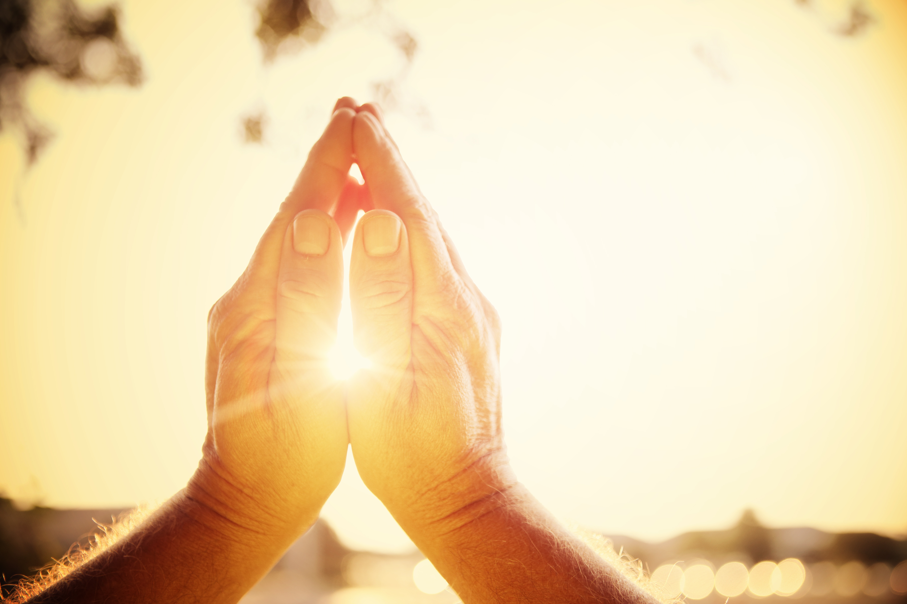
PRAYERS of the PEOPLE
Response after each petition is:
“Your Mercy Is Great”

Slide 63
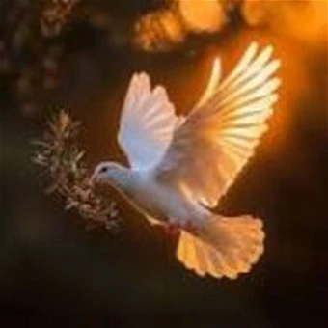
Passing of the Peace
P: The peace of the
Lord be with you
always.
C: And also
with you.
(Share the sign of peace
in the manner you feel most comfortable.)

Slide 64
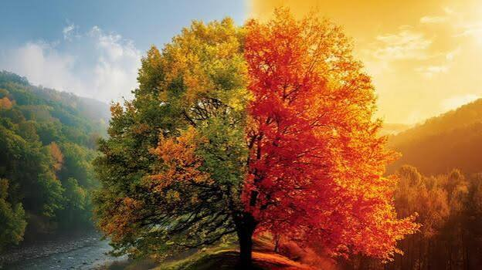
OFFERTORY:
“Can You Feel The Seasons Turning”- com. Donna Adkins

Slide 65
CONGREGATIONAL OFFERTORY
“In The Singing”
ELW # 466
\

Slide 66
1
In the singing,
in the silence,
in the hands expectant,
open,

Slide 67
in the blessing,
in the breaking,
in your presence
at this table,

Slide 68
Refrain
Jesus Christ, Jesus Christ,
be the wine of grace;
Jesus, Christ, Jesus Christ,
be the bread of peace.

Slide 69
2
In the question,
in the answer,
in the moment of acceptance,

Slide 70
in the heart's cry,
in the healing,
in the circle of your people,

Slide 71
Refrain
Jesus Christ, Jesus Christ,
be the wine of grace;
Jesus, Christ, Jesus Christ,
be the bread of peace.

Slide 72
Offertory Prayer
A: God of creation,
you send rain and the earth springs forth abundantly.
All blessings are from you;
make us generous with what we have.

Slide 73
A: Use our gifts, our abilities, and our hearts in service to you and in love
to our neighbors, today and always.
C: Amen.

Slide 74
The Sacrament of Communion
P: The Lord be with you.
C: And also with you.
P: Lift up your hearts.
C: We lift them to the Lord.

Slide 75
P: Let us give thanks to the Lord our
God.
C: It is right to give our thanks
and praise.

Slide 76
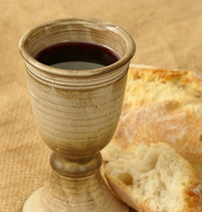

It is indeed right…

Slide 77
SANCTUS:
“Holy, Holy,
Holy Lord”
ACS Setting 12

Slide 78
Holy, holy, holy Lord,
God of pow’r and God of might,
heaven and earth are full of your glory.
Hosanna in the highest.

Slide 79
Blessed is the one
who comes in the name of the Lord.
Hosanna, hosanna in the highest.
Hosanna, hosanna in the highest.

Slide 80
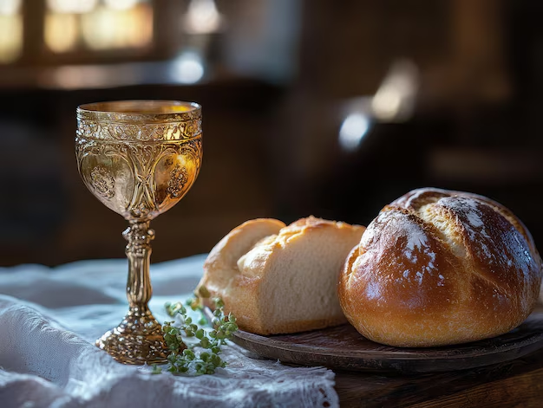
Eucharistic
Prayer
__________
Words of
Institution

Slide 81
The Lord’s Prayer
Our Father,
who art in heaven,
hallowed be thy name,
thy kingdom come,
thy will be done,
on earth as it is in heaven.

Slide 82
Give us this day
our daily bread;
and forgive us
our trespasses,
as we forgive those
who trespass against us;

Slide 83
and lead us not
into temptation,
but deliver us from evil.
For thine is the kingdom,
and the power, and the glory,
forever and ever. Amen.

Slide 84
Invitation to Communion
P: Christ invites you to this table.
All who are thirsty, all who are hungry, come!
C: Amen.
~~~~~~~~~~~~~~~~~~~~~~~~~~~~~~~~~~~
ALL baptized Christians are welcome at the Lord’s table.
ALTAR RAIL communion will be observed today.
Gluten-free wafers and clear apple juice are available.
If you would like to receive communion at your seat,
please let the usher know.

Slide 85
“LAMB OF GOD”
ELW Page 182

Slide 86
O Lamb of God,
you take away the sin of the world;
have mercy upon us,
have mercy upon us.

Slide 87
O Lamb of God,
you take away the sin of the world;
have mercy upon us,
have mercy upon us.

Slide 88
O Lamb of God,
you take away the sin of the world;
grant us your peace,
grant us your peace.

Slide 89
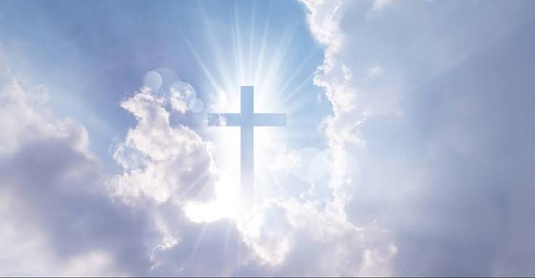
Communion Meditation: 11:00 AM
“Holy, Holy, Holy Lord”-arr. Lily Topolski
Notes:
8:15 AM SERVICE—SKIP THIS SLIDE—THIS IS FOR 11:00 AM ONLY

Slide 90
DISTRIBUTION HYMNS:
“Let Us Go Now To The Banquet”
ELW # 523

Slide 91
Refrain
Let us go now to the banquet,
to the feast of the universe.
The table's set and
a place is waiting;
come, ev'ryone,
with your gifts to share.

Slide 92
1
I will rise in the early morning;
the community's waiting for me.
With a spring in my step I'm walking
with my friends and my family.

Slide 93
Refrain
Let us go now to the banquet,
to the feast of the universe.
The table's set and
a place is waiting;
come, ev'ryone,
with your gifts to share.

Slide 94
2
God invites all the poor and hungry
to the banquet of justice and good
where the harvest
will not be hoarded
so that no one will lack for food.

Slide 95
Refrain
Let us go now to the banquet,
to the feast of the universe.
The table's set and
a place is waiting;
come, ev'ryone,
with your gifts to share.

Slide 96
3
May we build such
a place among us
where all people are equal in love.
God has called us to work together
and to share ev'rything we have.

Slide 97
Refrain
Let us go now to the banquet,
to the feast of the universe.
The table's set and
a place is waiting;
come, ev'ryone,
with your gifts to share.

Slide 98
Because He Lives
CCLI #16880

Slide 99
1. God sent His Son
they called Him Jesus
He came to love
heal and forgive

Slide 100
He bled and died
to buy my pardon
An empty grave is there
to prove My Savior lives

Slide 101
(CHORUS)
Because He lives
I can face tomorrow
Because He lives
all fear is gone

Slide 102
Because I know
He holds the future
And life is worth the living
just because He lives

Slide 103
2. How sweet to hold
a newborn baby
And feel the pride
and joy he gives

Slide 104
But greater still
the calm assurance
This child can face uncertain days because Christ lives

Slide 105
(CHORUS)
Because He lives
I can face tomorrow
Because He lives
all fear is gone

Slide 106
Because I know
He holds the future
And life is worth the living
just because He lives

Slide 107
3. And then one day
I'll cross that river
I'll fight life's final
war with pain

Slide 108
And then as death
gives way to vict’ry
I'll see the lights of glory
and I'll know He reigns

Slide 109
(CHORUS)
Because He lives
I can face tomorrow
Because He lives
all fear is gone

Slide 110
Because I know
He holds the future
And life is worth the living
just because He lives

Slide 111
“Soul Adorn Yourself
With Gladness”
ELW # 488

Slide 112
1
Soul, adorn yourself with gladness,
leave the gloomy haunts of sadness,
come into the daylight's splendor,
there with joy your praises render.

Slide 113
Bless the one whose grace unbounded
this amazing banquet founded;
Christ, though heav'nly, high, and holy,
deigns to dwell with you most lowly.

Slide 114
2
Hasten as a bride to meet him,
eagerly and gladly greet him.
There he stands already knocking;
quickly, now, your gate unlocking,

Slide 115
open wide the fast-closed portal,
saying to the Lord immortal:
"Come, and leave your loved one never;
dwell within my heart forever.“

Slide 116
3
Now in faith I humbly ponder
over this surpassing wonder
that the bread of life is boundless
though the souls it feeds are countless;

Slide 117
with the choicest wine of heaven
Christ's own blood to us is given.
Oh, most glorious consolation,
pledge and seal of my salvation.

Slide 118
4
Jesus, source of lasting pleasure,
truest friend, and dearest treasure,
peace beyond all understanding,
joy into all life expanding:

Slide 119
humbly now, I bow before you,
love incarnate, I adore you;
worthily let me receive you,
and, so favored, never leave you.

Slide 120
Communion Blessing
P: The body and blood of our Lord Jesus Christ strengthen you and
keep you in His grace.
C: Amen.

Slide 121

Prayer after Communion
A: Sustaining God, with this bread and
cup, you nourish us with mercy and
abundant life. By your Spirit, send us
from this table to serve a needy world.

Slide 122
A: Make us living signs of your liberation,
healing, and love, following the way
of Jesus, in whose name we pray.
C: Amen.

Slide 123
BLESSING
P: The God of love
draw you into full accord and one
mind, in the body of Christ Jesus.
C: Amen

Slide 124
P: The God of hope
grant you strength and joy in all circumstances through the interceding of the Spirit.
C: Amen

Slide 125
P: The God of grace ☩
bless you now and forever.
C: Amen

Slide 126
“Great Is The Lord”
CCLI # 1149
Shout to the Lord

Slide 127
Verse
Great is the Lord
He is holy and just
By His power
we trust in His love

Slide 128
Great is the Lord
He is faithful and true
By His mercy He proves
He is love

Slide 129
Chorus 1
Great is the Lord
And worthy of glory
Great is the Lord
And worthy of praise

Slide 130
Great is the Lord
Now lift up your voice
Now lift up your voice
Great is the Lord

Slide 131
Chorus 2
Great are You Lord
And worthy of glory
Great are You Lord
And worthy of praise

Slide 132
Great are You Lord
I lift up my voice
I lift up my voice
Great are You Lord

Slide 133
Ending
Great are You Lord
Great are You Lord
Great are You Lord
Great are You Lord

Slide 134
Sending
A: Go out in joy.
Be led forth in peace.
C: Thanks be to God.

Slide 135
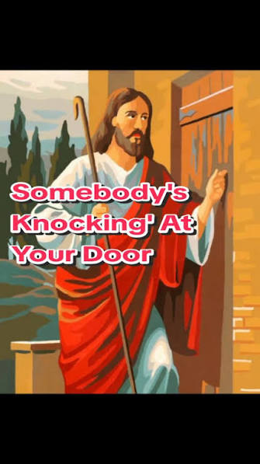
POSTLUDE
Arr. Thomas Keesecker

